Slide 1

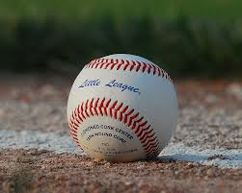
Oregon D7 Managers and Coaches Meeting
2026

Slide 2
D7 Umpire Consultants
Baseball/Softball
Eric Anderson
Barry Nelson

Slide 3
Purpose of Meeting
Reinforce tournament guidelines to coaches and managers in order to promote a smooth tournament so that all who participate may have an enjoyable experience
Hold general questions to the end

Slide 4
2026 Rule Books
Significant updates, as well as all other updates to the 2026 Rulebook can also be found in the Little League Rulebook App, available for download on both the Apple and Google Play App stores. More information, including how to download the app, can be found at LittleLeague.org/RulebookApp.

Slide 5
Sportsmanship
We are all volunteers. Some are better than others.
Some are better coaches or managers
Some are better umpires than others
There even may be a better tournament committee
However, we are all committed to doing our best for the kids we serve. Please keep that in mind.
Positive sportsmanship is expected

Slide 6

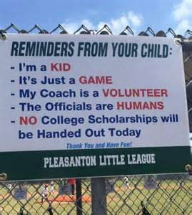

Slide 7
LOGISTICS

Slide 8
Team Expectations
Managers be prepared for a Coin Flip at 1 hour before play time. The team which traveled furthest shall call the first flip.
Turn in your line up card (designate on the top if you are home or visitor) AND affidavit book 1 hour before game time to the scorekeeper.
Visitor – 1st base dugout, Home – 3rd base dugout
30 minutes before start time – Visitor takes infield (for 10 mins)
20 minutes before start time – Home takes infield (for 10 mins)
30 minutes before start time – Umpires will do a courtesy equipment check
10 minutes before start time – Umpires/Managers Meeting at Home plate
Lineup Announcements, if site provides
Little League Pledge

Slide 9
During the Game
Coaches SHALL NOT warm up pitchers at any time
A Catcher with a mask must be used during any drills
Bullpen catchers must wear a mask
Helmets must be worn during hitting drills & during game when batting or on the field for other reason (retrieving bat, etc.)
NO talking to ANYONE outside the dugout
Ask to go to the restroom – Go there and back only

Slide 10
Safety
Hydrate
First Aid Station
  Baseball – Scorekeeper’s Tent
  Softball – Scorekeeper’s Tent
Report issues to D7 or Little League Staff

Slide 11
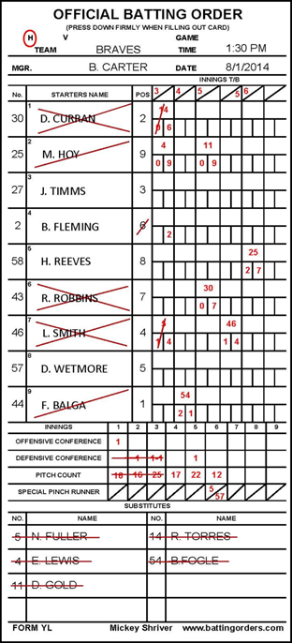
Lineup card
Provided by D7
Deliver copy with Affidavit binder 1 hour prior to game
Umpires will get copies from scorekeeper
Write hard so it shows up on all copies
First initial, last name for all players
Numbers and positions for all players
When making substitutes, use player # and position
  (#9 for #6 at pitcher; #23 is going in as catcher)
Report all DEFENSIVE substitutions at start of ½ inning, OFFENSIVE when they come to bat

Slide 12
Equipment

Slide 13
Equipment
Managers are required to ensure equipment is safe and legal
Check your equipment before you leave for the tournament
  Have players leave illegal equipment at home!
Inspection 30 min prior to each game

Slide 14
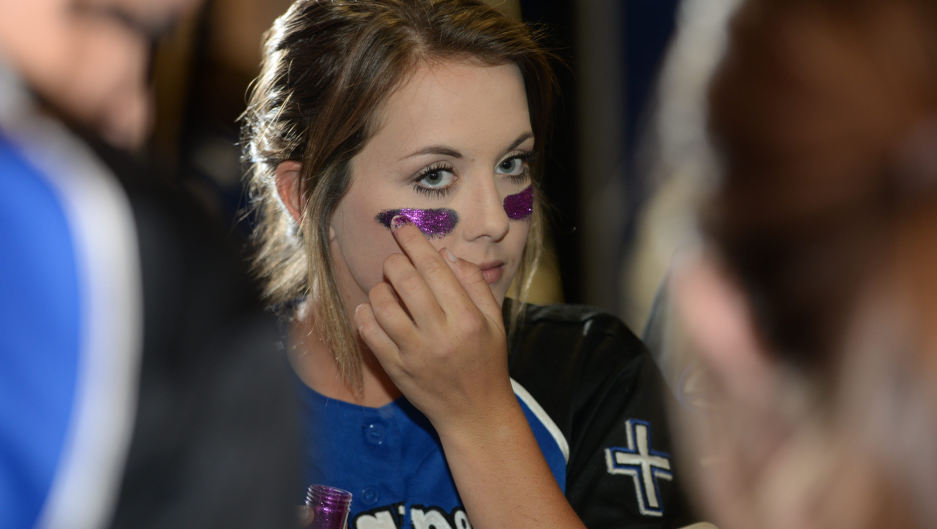
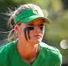
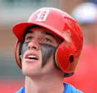
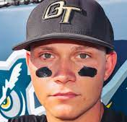
Eye Black
Single line under eye or single line sticker
No other eye black or other items on face. No writing on stickers
If player does not comply, they are choosing not to participate in tournament
Acceptable
Not Acceptable

Slide 15
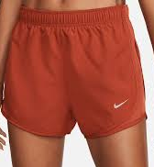
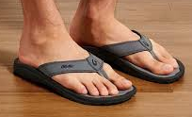
Manager/Coaches Attire Expectations
Slacks, dockers, cargo style shorts
Collared shirt or team jersey
Tennis shoes
Intermediate/JR/SR ONLY – May wear baseball pants

Slide 16
Jewelry
Jewelry is allowed
  Any jewelry worn by a player that poses a danger of harm or injury will be subject to removal
Medial Alert bracelet or necklace is acceptable

Slide 17
Bats
Baseball
USA Baseball Logo
  Juniors and below
BBCOR & USA for Int/JR/SR BB
Softball
BPF 1.20
Baseball and Softball
Solid one-piece wood bats
Rule 1.10
Cannot be dented or cracked
Pine tar or adhesive is acceptable
No missing or damaged grip/tape

Slide 18
Illegal Bat Penalty
The batter is out
Defensive manager option to take the penalty or
accept the play. Election must be made immediately at the end of the play.
Offensive manager is removed for the remainder of the International Tournament.
Batter ejected from the game
Offensive team will lose one eligible adult base
coach for the duration of the game.

Slide 19
Catcher’s Gear
Fits and is worn correctly
Males must wear a cup
Catcher may wear a long or short chest protector
Catcher's helmets must have a dangling throat guard
Catcher must wear mask during team infield practice
No missing straps/fasteners or padding
This is your only warning

Slide 20
Metal Spikes
Intermediate, Juniors, and Seniors
Softball and baseball

Slide 21
Gloves
Make sure your players wear the appropriate glove for the specific position
Baseball rule 1.12 to 1.14
Softball rule 1.12 to 1.15
  Pitcher's glove can’t be color of ball

Slide 22
Batting Helmets
Baseball and softball rule 1.16
MUST have manufacturer certification letter for ANY alteration of helmet
C-flap – Must be manufacturer approved. Get a letter from the manufacturer if you have questions. See LL website.
No missing or damaged padding. No tape.

Slide 23
Playing Rules

Slide 24
Seniors Softball & Baseball ONLY
No minimum regular season games required
No CBO or Mandatory Play
Special pinch runners allowed 1X per inning, 2X per game
Linked players
Offensive substitutions when they come to bat ONLY
Designated hitter (Rule 3.03)

Slide 25
Rules of note
Tie Game – Beginning with the first extra inning, the batter due up last is placed at 2B.
Softball Pitching – A pitcher removed from the circle may return as pitcher regardless of whether they move to another position on defense or to the bench.
Electronic Communication – A one way communication device may be used to the catcher.

Slide 26
Mandatory Play – Tournament Rule 9
All Divisions Except Seniors
Continuous Batting Order (CBO)
All players present at start of game
If player shows up late, add to bottom of order
If player injured/sick, remove from game and skip in batting order
Player with significant injury will require medical personnel note to play again
There is no defensive requirement for mandatory play

Slide 27
Significant BASEBALL Rules
1.10 – Bat Certification
Regulation VI(D) – Pitcher can’t pitch 3 consecutive days
TR4 – Pitching rules, including pitch count limitations
TR7 – Mound visit 1x per inning/2x game (8-9-10s 2x/3x)
9.01d – Unsportsmanlike behavior (stealing signs)
      Suspension of player and manager

Slide 28
Significant SOFTBALL Rules
1.15(c) allows solid color arm sleeve on either arm
8.01(q) Pitchers release MUST be past vertical line of body
9.01d – Unsportsmanlike behavior (stealing signs)
      Suspension of player and manager

Slide 29
Baseball Pitching Rules
Any player who has played the position of catcher in 4 or more innings is not eligible to pitch that day
Pitchers once removed from the mound may not return to pitch that day (majors & below)
A pitcher who delivers 41 or more pitches in a game may not catch that day
A player may not pitch in 2 games in a day or 3 consecutive days
If a player catches less than 4 innings and then moves to pitcher, they cannot return to the position of catcher if they pitch more than 21 pitches
Intermediate/Juniors/Seniors:
A pitcher remaining in the game but moving to a different position can return as a pitcher anytime in the remainder of the game but only once per game
Juniors/Seniors: If a player pitches 30 or less pitches in the 1st game, that player may pitch the second game of that day

Slide 30
Baseball Pitching Days Rest
66 plus pitches= 4 calendar days
51-65 pitches= 3 calendar days
36-50 pitches= 2 calendar days
21-35 pitches= 1 calendar day
1-20 pitches = no rest needed
Under no circumstances shall a player pitch in 3 consecutive days (all divisions)

Slide 31
Baseball Pitching Thresholds
If a pitcher reaches a day(s) of rest threshold while facing a batter, the pitcher may continue to pitch until any one of the following occurs:
That batter reaches base
That batter is retired
The third out is made to complete the inning
The pitcher will only be required to observe the calendar day(s) of rest for the threshold reached

Slide 32
Softball Pitching Rules – Majors & Below
Delivery of a single pitch constitutes having pitched an inning
A Player may not pitch in more than 12 innings in a day
A pitcher removed from the circle can return as a pitcher anytime in the remainder of the game, but only once in the same inning as he/she was removed
If a player pitches in less than seven (7) innings in a calendar day, no rest is required.
If a player pitches 7 or more innings in a day 1 calendar days rest is mandatory

Slide 33
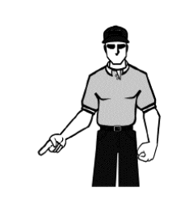
3rd Strike Not Caught – Baseball & Softball
This rule will be applied to all levels except
8, 9, 10 Tournament Division

Slide 34
Defensive Substitutions Given to Umpire
Baseball – Pitchers and catcher Only
Softball – Pitchers Only
Announce your substitutions to the umpire, every time you wish to substitute at the beginning of the half-inning

Slide 35
Unannounced Substitutions
No Excuses Period
Examples—Pitching change
Catcher--baseball

Slide 36
15 Run Rule
All levels of play for both softball and baseball
3 innings (2 ½ if home) or 4 innings (3 ½ for Int/JR/SR)
If one team has a lead of 15 runs or more the manager of the team with the least runs shall concede the victory to the opponent

Slide 37
10 Run Rule
All levels of play for both softball and baseball
4 innings (3 ½ if home) or 5 innings (4 ½ for Int/JR/SR)
If one team has a lead of 10 runs or more the manager of the team with the least runs shall concede the victory to the opponent

Slide 38
Visits
A manager or coach may not leave the dugout for any reason during a game without receiving permission from an umpire
If granted time out to talk to a pitcher, you will be charged with a visit to the pitcher. If you announce a change before talking to defensive players, it does not count as a visit.
1 visit per inning (2x 8-9-10) – 2 per game (3X 8-9-10)
2 visits per game – 3rd visit must remove pitcher (3X 8-9-10)
This rule applies to each pitcher who enters a game
Only 1 offensive conference per inning

Slide 39
When do Umpires Call Time?
Wait for all play to finish and runners to reach base
On a walk wait for runners to reach base
Please wait for the umpire to grant time
Pitch count any time

Slide 40
Injury or Illness
If a player is injured or becomes ill during a game, the decision of a doctor (if present) or medical personnel will be final as to whether the player may continue in the game for significant injury/illness
Player is scratched from the batting order with no penalty
If injured player returns to the lineup, they are put back into the original position in the batting order.

Slide 41
Altercations and Ejections
Any player, manager, coach, or official who is involved in a physical or verbal altercation at the game site could be suspended or removed by the Tournament Committee
There will be a suspension for the next physically played game. Ejections shall be noted in the tournament team’s affidavit in the Record of Ejections page 4

Slide 42
How to Protest?
Wait for the play to finish and time to be granted by umpire
Go to the calling umpire and ask your question. Be calm.
Remember there are no protests on judgment calls. Only rule violations.
Wait for the umpire to make their ruling. If you disagree with the umpire’s ruling, state “I want to protest”. Don’t play any further until the protest is resolved. If you do, protest is no longer valid.

Slide 43
Protests
Ineligible player
Ineligible pitcher
Rules interpretation

Slide 44
Protests
If there is a delay for a rule clarification/protest;
Discussion of rule interpretations may require a delay in the action to resolve. The officials involved will attempt to resolve any issues as quickly as possible. All rulings will be final after the next pitch. We want to ensure that the right decision is made for all players involved. We thank you for your understanding.

Slide 45
Points of Emphasis
SIGN YOUR BOOK AT THE END OF THE GAME
NO CHANGES OR ADJUSTMENTS WILL BE MADE AFTER YOU LEAVE THE TOURNAMENT DIRECTOR TABLE WITH YOUR BOOK
CONFIRM PITCHER PITCH COUNTS (baseball) OR INNINGS PITCHED (softball)

Slide 46
Points of Emphasis
UMPIRES are volunteers
If a manager has a question, request time-out, go to the umpire who made the call and ask them your question
No yelling across the field or poor sportsmanship will be allowed

Slide 47
GOOD LUCK
Remember it’s a game – HAVE FUN!
QUESTIONS?

